Slide 1

Concepts in Enterprise Resource Planning
Fourth Edition
Chapter Three
Marketing Information Systems and the Sales Order Process

Slide 2
Objectives
After completing this chapter, you will be able to:
Describe the unintegrated sales processes of the fictitious Fitter Snacker company
Explain why unintegrated Marketing and Sales information systems lead to company-wide inefficiency, higher costs, lost profits, and customer dissatisfaction
Discuss sales and distribution in the SAP ERP system, and explain how integrated data sharing increases company-wide efficiency
Concepts in Enterprise Resource Planning, Fourth Edition
Concepts in Enterprise Resource Planning, Fourth Edition

Slide 3
Objectives (cont’d.)
Describe how SAP ERP processes a standard sales order
Describe the benefits of customer relationship management (CRM) software
Concepts in Enterprise Resource Planning, Fourth Edition
Concepts in Enterprise Resource Planning, Fourth Edition

Slide 4
Introduction
Fitter Snacker (FS)
  Fictitious company that makes healthy snack bars
  Does not have an integrated information system
Marketing and Sales (M/S) is the focal point of many of FS’s activities
FS’s M/S information systems are not well integrated with company’s other information systems
  Company-wide use of transaction data is inefficient
Concepts in Enterprise Resource Planning, Fourth Edition

Slide 5
Overview of Fitter Snacker
Manufactures and sells two types of nutritious snack bars:
  NRG-A: “advanced energy”
  NRG-B: “body building proteins”
Has organized its sales force into two groups, known as divisions:
  Wholesale Division
  Direct Sales Division
Concepts in Enterprise Resource Planning, Fourth Edition

Slide 6
Overview of Fitter Snacker (cont’d.)
The two sales divisions differ in terms of quantities of orders and pricing terms
Sells snack bars under the Fitter Snacker brand name
Packages the bars in store-brand wrappers for some chain stores
Concepts in Enterprise Resource Planning, Fourth Edition

Slide 7
Problems with Fitter Snacker’s Sales Process
Many of Fitter Snacker’s sales orders have problems, such as:
  Incorrect pricing
  Excessive calls to the customer for information
  Delays in processing orders
  Missed delivery dates
Concepts in Enterprise Resource Planning, Fourth Edition

Slide 8
Problems with Fitter Snacker’s Sales Process (cont’d.)
Reasons for problems:
  FS has separate information systems throughout the company for three functional areas:
    Sales order system
    Warehouse system
    Accounting system
  High number of transactions that are handled manually
  Information stored in the three systems is not available in real time
Concepts in Enterprise Resource Planning, Fourth Edition

Slide 9
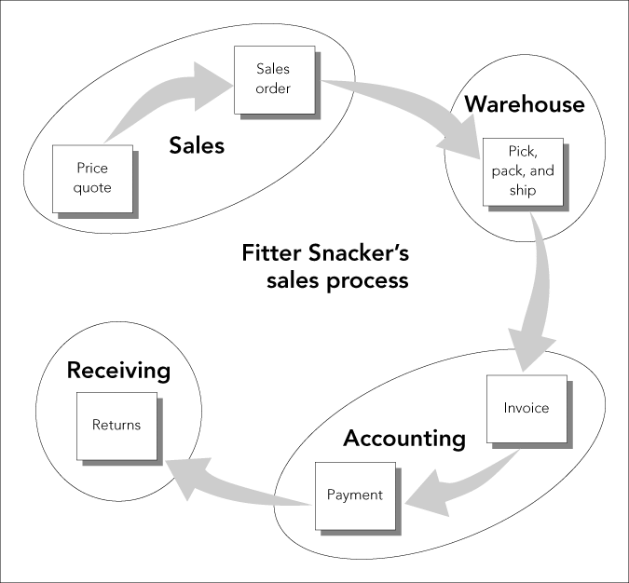
Problems with Fitter Snacker’s Sales Process (cont’d.)
Figure 3-1 The sales process
Concepts in Enterprise Resource Planning, Fourth Edition
Concepts in Enterprise Resource Planning, Fourth Edition

Slide 10
Sales Quotations and Orders
Giving a customer a price quotation and then taking the customer’s order at FS
  Sales call: salesperson either telephones the customer or visits in person
  At the end of sales call, salesperson prepares a handwritten quotation on a form that generates two copies
    Original sheet goes to the customer
    Middle copy is first faxed and then mailed to the sales office
    Salesperson keeps the bottom copy for his or her records
Concepts in Enterprise Resource Planning, Fourth Edition

Slide 11
Sales Quotations and Orders (cont’d.)
Giving a customer a price quotation and then taking the customer’s order at FS (cont’d.)
  Quotation form has an 800 number that the customer can call to place an order
Problems can occur with this process
Inefficiencies in the rest of the ordering process
  Determining the delivery date
  Checking customer’s credit status
  Entering customer’s order into the current order entry system
Concepts in Enterprise Resource Planning, Fourth Edition

Slide 12
Order Filling
Packing lists and shipping labels
  Printed twice a day
  Hand-carried to the warehouse
  At warehouse, hand-sorted into small orders and large orders
Warehouse
  Small-order packing area
  Large-order packing area
FS uses a PC database program to manage inventory levels in the warehouse
Concepts in Enterprise Resource Planning, Fourth Edition

Slide 13
Order Filling (cont’d.)
FS keeps inventory levels fairly low, and inventory levels change rapidly during the day
  Picker might go to the shelves to pick an order and discover that there are not enough of the desired type of snack bars to fill the order
  To determine what to do in this situation, order picker might have conversations with warehouse supervisor, production supervisor, and sales clerks
Concepts in Enterprise Resource Planning, Fourth Edition

Slide 14
Accounting and Invoicing
Invoicing the customer is problematic
Sales clerks send the Accounting department the sales order data for customer invoices
Accounting department loads the data into PC-based accounting program
Clerks manually make adjustments for partial shipments and any other changes
Sometimes, order corrections are delayed and don’t catch up to the invoicing process
  Results in late or inaccurate invoices
Concepts in Enterprise Resource Planning, Fourth Edition

Slide 15
Payment and Returns
Problems with procedure for processing payments
  If any errors have occurred in the sales process, customer will receive an incorrect invoice
  Many customers don’t return a copy of the invoice with their payment; errors can result
Concepts in Enterprise Resource Planning, Fourth Edition

Slide 16
Payment and Returns (cont’d.)
FS’s returns processing is flawed
  Many customers do not call for the RMA number, or fail to include it with their returned material
    Makes it more difficult for Accounting department to credit the appropriate account
  Poor penmanship on the returned material sheet can create problems for Accounting
If a customer’s account has not been properly credited, customer may receive a dunning letter in error
Concepts in Enterprise Resource Planning, Fourth Edition

Slide 17
Sales and Distribution in ERP
ERP systems can minimize data entry errors and provide accurate information in real time to all users
ERP systems can track all transactions (such as invoices, packing lists, RMA numbers, and payments) involved in the sales order
Concepts in Enterprise Resource Planning, Fourth Edition

Slide 18
Sales and Distribution in ERP (cont’d.)
SAP ERP Sales and Distribution module treats the sales order process as a cycle of events:
  Pre-sales activities
  Sales order processing
  Inventory sourcing
  Delivery
  Billing
  Payment
Concepts in Enterprise Resource Planning, Fourth Edition

Slide 19
Pre-Sales Activities
Customers can get pricing information about the company’s products:
  Through an inquiry or a price quotation
Marketing activities such as tracking customer contacts, including sales calls, visits, and mailings
Company can maintain data about customers and generate mailing lists based on specific customer characteristics
Concepts in Enterprise Resource Planning, Fourth Edition

Slide 20
Sales Order Processing
Sales order processing: series of activities that must take place to record a sales order
Sales order can start from a quotation or inquiry generated in the pre-sales step
Information collected from the customer to support the quotation is immediately included in sales order
Critical steps in sales order processing:
  Recording the items to be purchased
  Determining the selling price
  Recording the order quantities
Concepts in Enterprise Resource Planning, Fourth Edition

Slide 21
Sales Order Processing (cont’d.)
Users can define various pricing alternatives in the SAP ERP system
SAP ERP system checks the Accounts Receivable tables in the SAP ERP database to confirm the customer’s available credit
If customer has sufficient credit available
  Order is completed
If customer does not have sufficient credit available
  SAP ERP system prompts sales personnel to take one of the possible appropriate actions
Concepts in Enterprise Resource Planning, Fourth Edition

Slide 22
Inventory Sourcing
Available-to-Promise (ATP) check
  SAP ERP system checks company’s inventory records and production planning records to see whether:
    Requested material is available
    Requested material can be delivered on the date the customer desires
  Includes expected shipping time
System can recommend an increase in planned production if a shortfall is expected
Concepts in Enterprise Resource Planning, Fourth Edition

Slide 23
Delivery
Delivery in SAP ERP system
  Releasing the documents that the warehouse uses to pick, pack, and ship orders
Delivery process allows deliveries to be created so that the warehouse and shipping activities are carried out efficiently
Once the system has created documents for picking, packing, and shipping, documents are transferred to Materials Management module
Concepts in Enterprise Resource Planning, Fourth Edition

Slide 24
Billing
SAP ERP system creates an invoice by copying sales order data into the invoice document
Accounting can print this document and mail it, fax it, or transmit it electronically to the customer
Accounting records are updated at this point
Concepts in Enterprise Resource Planning, Fourth Edition

Slide 25
Payment
When the customer sends in a payment, it is automatically processed by the SAP ERP system
  Debits cash and credits (reduces) customer’s account
Timely recording of this transaction has an effect on the timeliness and accuracy of any subsequent credit checks for the customer
Concepts in Enterprise Resource Planning, Fourth Edition

Slide 26
A Standard Order in SAP ERP
How Fitter Snacker’s sales order process would work with an SAP ERP system in place
How the ERP system would make FS’s sales order process more accurate and efficient
ERP allows business processes to cut across functional area lines
Concepts in Enterprise Resource Planning, Fourth Edition

Slide 27
Taking an Order in SAP ERP
Order entry screen in SAP ERP’s 4.7 Enterprise system
A unique number is assigned by the company to each customer in the database
For most data entry fields, SAP ERP system determines whether an entry is valid
Search screen for customers
Concepts in Enterprise Resource Planning, Fourth Edition

Slide 28
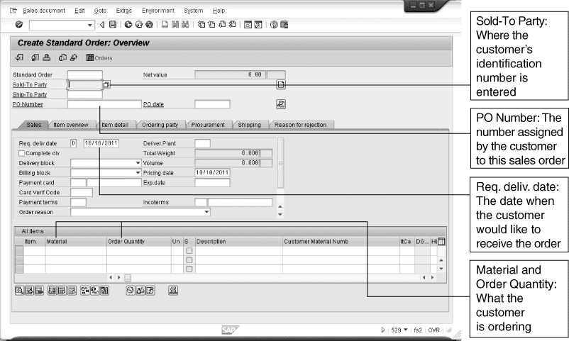
Taking an Order in SAP ERP (cont’d.)
Figure 3-2 SAP ERP order entry screen
Concepts in Enterprise Resource Planning, Fourth Edition

Slide 29
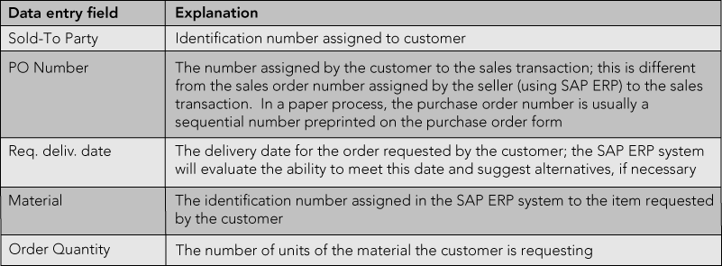
Taking an Order in SAP ERP (cont’d.)
Figure 3-3 Data entry fields in the order entry screen
Concepts in Enterprise Resource Planning, Fourth Edition

Slide 30
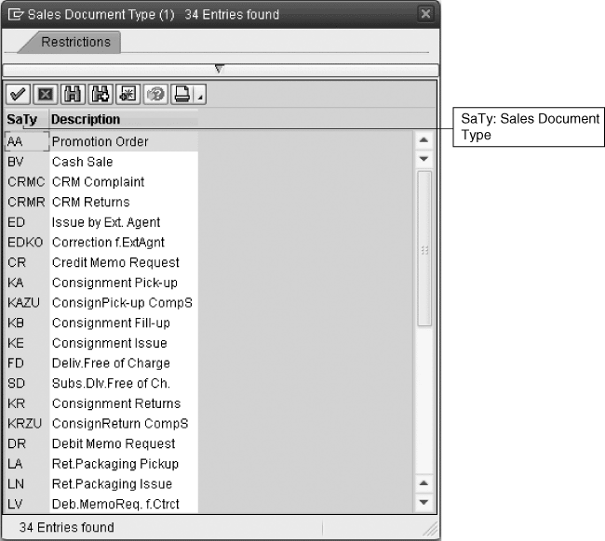
Taking an Order in SAP ERP (cont’d.)
Figure 3-4 Some of the sales order document types predefined in SAP ERP
Concepts in Enterprise Resource Planning, Fourth Edition

Slide 31
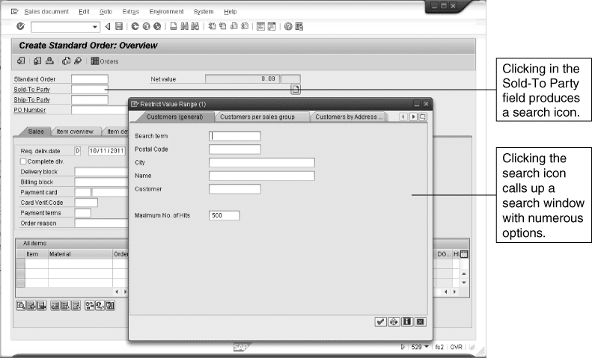
Taking an Order in SAP ERP (cont’d.)
Figure 3-5 Search screen for customers
Concepts in Enterprise Resource Planning, Fourth Edition

Slide 32
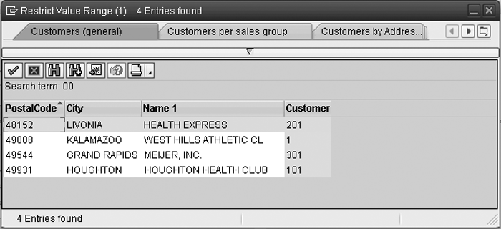
Taking an Order in SAP ERP (cont’d.)
Figure 3-6 Result of customer search
Concepts in Enterprise Resource Planning, Fourth Edition

Slide 33
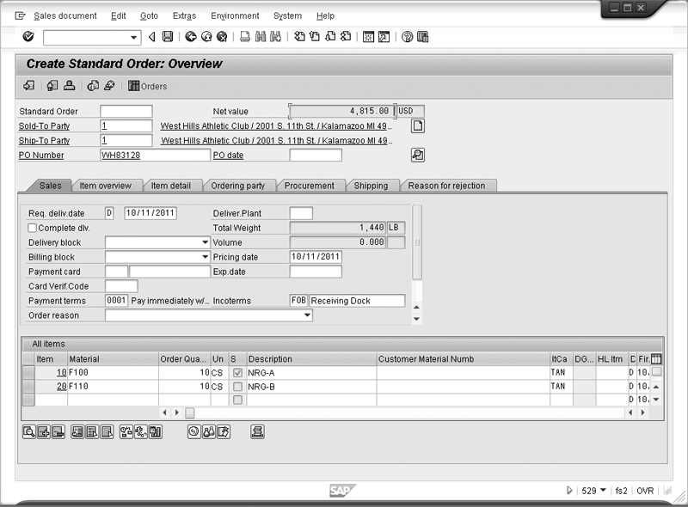
Taking an Order in SAP ERP (cont’d.)
Figure 3-7 Order screen with complete date
Concepts in Enterprise Resource Planning, Fourth Edition

Slide 34
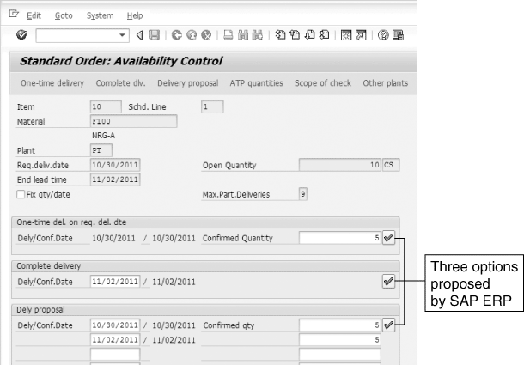
Taking an Order in SAP ERP (cont’d.)
Figure 3-8 Order proposals
Concepts in Enterprise Resource Planning, Fourth Edition

Slide 35
Taking an Order in SAP ERP (cont’d.)
Customer master data
Master data: data that remain fairly stable
  Maintained in the central database and available to all SAP ERP modules
Material master data
Organizational structures
  SAP ERP system allows the user to define various ways to group customers and salespeople
  Distribution Channel
Concepts in Enterprise Resource Planning, Fourth Edition

Slide 36
Taking an Order in SAP ERP (cont’d.)
When a sales order is saved, SAP ERP system assigns a document number to the sales order transaction
SAP ERP system keeps track of the document numbers for the sales order
  Employees can track status of an order while it is in process or research it after shipping
Document flow in SAP ERP: linked set of document numbers related to an order
Concepts in Enterprise Resource Planning, Fourth Edition

Slide 37
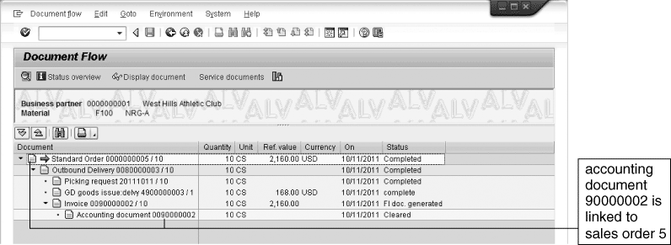
Taking an Order in SAP ERP (cont’d.)
Figure 3-9 The Document Flow tool, which links sales order documents
Concepts in Enterprise Resource Planning, Fourth Edition

Slide 38
Discount Pricing in SAP ERP
When a company installs an ERP system, it can configure it for a number of pricing strategies
Various kinds of discounts can be allowed
As a safeguard, system can enforce limits on the size of discounts
Condition technique
  Control mechanism developed by SAP to accommodate various ways that companies offer price discounts
Concepts in Enterprise Resource Planning, Fourth Edition

Slide 39
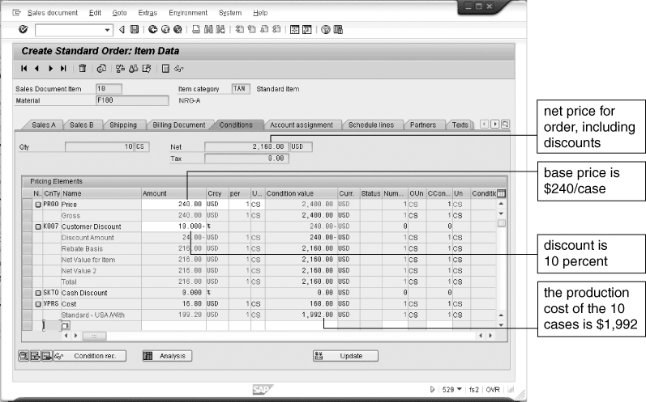
Discount Pricing in SAP ERP (cont’d.)
Figure 3-10 Pricing conditions for sales order
Concepts in Enterprise Resource Planning, Fourth Edition

Slide 40
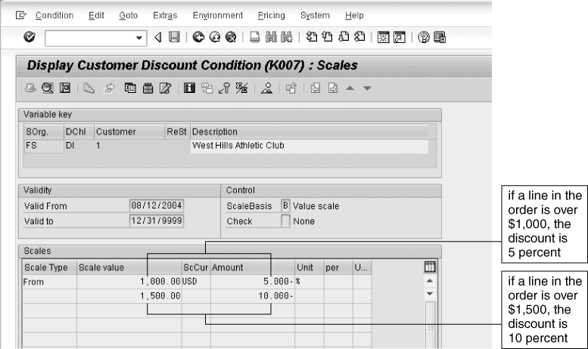
Integration of Sales and Accounting (cont’d.)
Figure 3-11 West Hills Athletic Club price Discount
Concepts in Enterprise Resource Planning, Fourth Edition

Slide 41
Integration of Sales and Accounting
ERP systems integrate Accounting with all business processes
When a sales order is recorded, related accounting data are updated automatically
Concepts in Enterprise Resource Planning, Fourth Edition

Slide 42
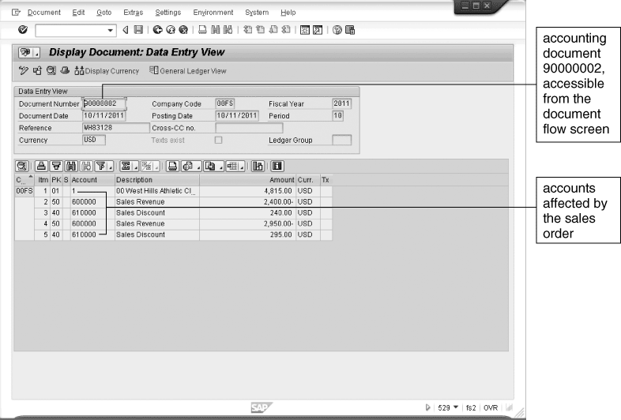
Integration of Sales and Accounting (cont’d.)
Figure 3-12 Accounting detail for the West Hills sales order
Concepts in Enterprise Resource Planning, Fourth Edition

Slide 43
Customer Relationship Management
Companies without a good connection between their workers and their customers run the risk of losing business
Customer relationship management (CRM) software can help companies streamline their interactions with customers
On-demand CRM: software and computer equipment reside with CRM provider
Concepts in Enterprise Resource Planning, Fourth Edition

Slide 44
Core CRM Activities
One-to-one marketing
Sales force automation (SFA)
Sales campaign management
Marketing encyclopedias
Call center automation
Concepts in Enterprise Resource Planning, Fourth Edition

Slide 45
SAP’s CRM Software
Examples of tools that provide CRM functionality within the SAP ERP system
  Contact management tool
    To make sure that information about sales contacts is available throughout the organization
  Sales activity manager
    Supports a strategic and organized approach to sales activity planning and can help make sure that follow-up activities are accomplished
Employing a separate CRM system that communicates with the ERP system
Concepts in Enterprise Resource Planning, Fourth Edition

Slide 46
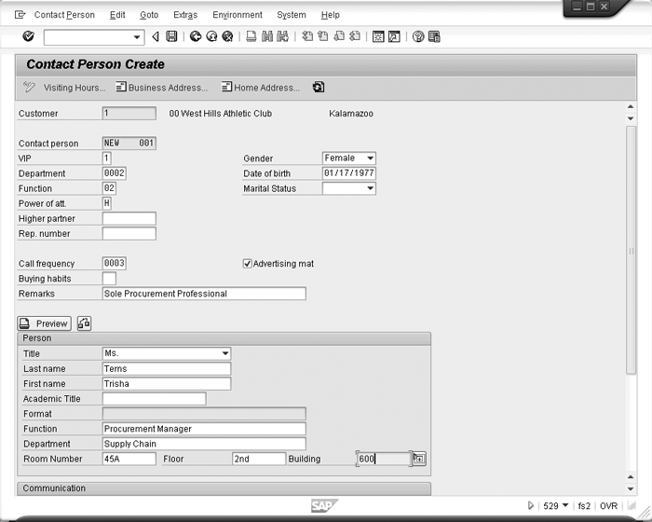
SAP’s CRM Software
Figure 3-13 SAP ERP contact manager
Concepts in Enterprise Resource Planning, Fourth Edition

Slide 47
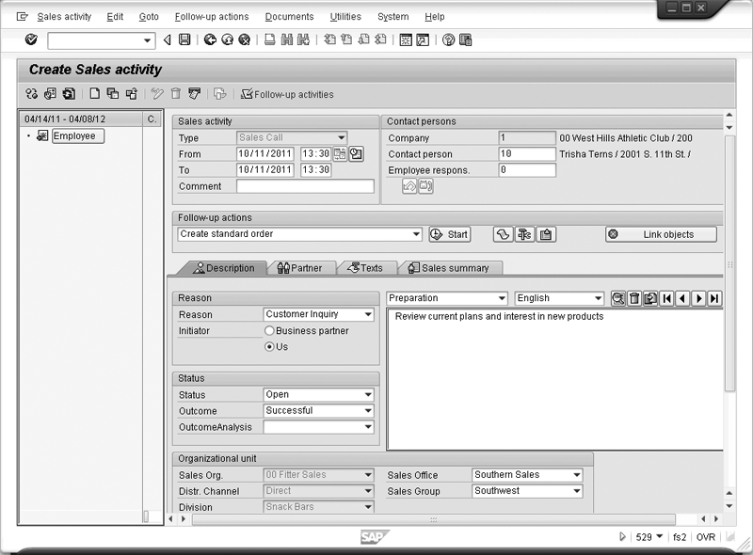
SAP’s CRM Software
Figure 3-14 SAP ERP sales activity manager
Concepts in Enterprise Resource Planning, Fourth Edition

Slide 48
SAP’s CRM Software (cont’d.)
SAP ERP system processes business transactions and provides much of the raw data for CRM
SAP’s Business Warehouse: system for reporting and analysis of transactional data
Advanced Planner and Optimizer (APO): system that supports efficient planning of the supply chain
SAP’s view of CRM is to provide a set of tools to manage the three basic task areas, or jobs:
  Marketing, sales, and service
Concepts in Enterprise Resource Planning, Fourth Edition

Slide 49
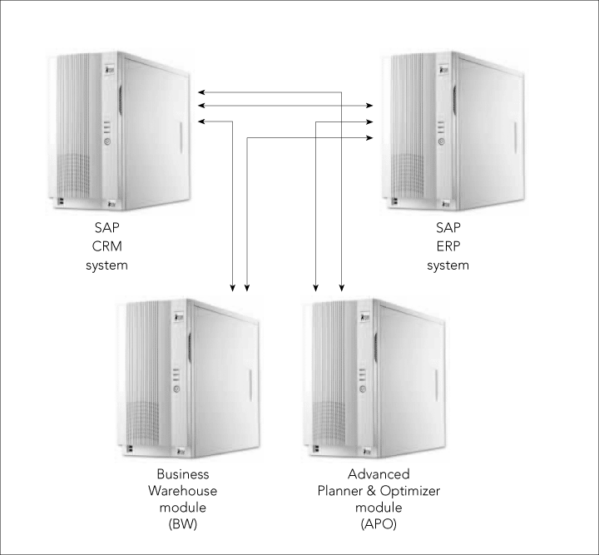
SAP’s CRM Software (cont’d.)
Figure 3-15 SAP CRM system landscape
Concepts in Enterprise Resource Planning, Fourth Edition

Slide 50
SAP’s CRM Software (cont’d.)
Four phases of the cultivation of customer relationship:
  Prospecting
  Acquiring
  Servicing
  Retaining
Contact Channels
Marketing and Campaign Management
Campaign Execution Activity Management
Campaign Analysis tool
Concepts in Enterprise Resource Planning, Fourth Edition

Slide 51
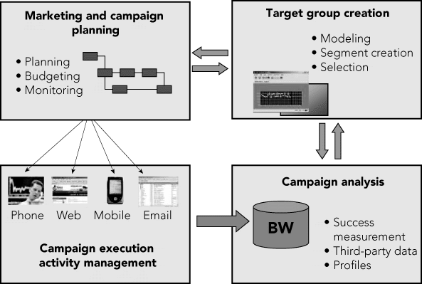
SAP’s CRM Software (cont’d.)
Figure 3-16 Marketing and campaign planning
Concepts in Enterprise Resource Planning, Fourth Edition

Slide 52
The Benefits of CRM
Lower costs
Higher revenue
Improved strategy and performance measurement
Concepts in Enterprise Resource Planning, Fourth Edition

Slide 53
Summary
Fitter Snacker’s unintegrated information systems are at the root of an inefficient and costly sales order process
An ERP system such as SAP ERP treats a sale as a sequence of related functions
  Including: taking orders, setting prices, checking product availability, checking the customer’s credit line, arranging for delivery, billing the customer, and collecting payment
  In SAP ERP, all these transactions, or documents, are electronically linked
Concepts in Enterprise Resource Planning, Fourth Edition

Slide 54
Summary (cont’d.)
Installing an ERP system means making various configuration decisions
  Configuration decisions reflect management’s view of how transactions should be recorded and later used for decision making
ERP system’s central database contains:
  Tables of master data: relatively permanent data about customers, suppliers, material, and inventory
  Transaction data tables: store relatively temporary data such as sales orders and invoices
Concepts in Enterprise Resource Planning, Fourth Edition

Slide 55
Summary (cont’d.)
Customer relationship management (CRM) systems
  Build on the organizational value that ERP provides
  Specifically increase the flexibility of the company’s common database regarding customer service
  Various kinds of CRM software are available
  Can be installed in-house or on-demand
Concepts in Enterprise Resource Planning, Fourth Edition

